Slide 1

MYLEGION: ONLINE MEMBERSHIP PROCESSING
Renew, transfer and add new members using squadron online membership processing.
2026
Notes:
MyLegion is a secure website for American Legion and Sons of the American Legion members. View and manage membership information through MyLegion.org.

Slide 2
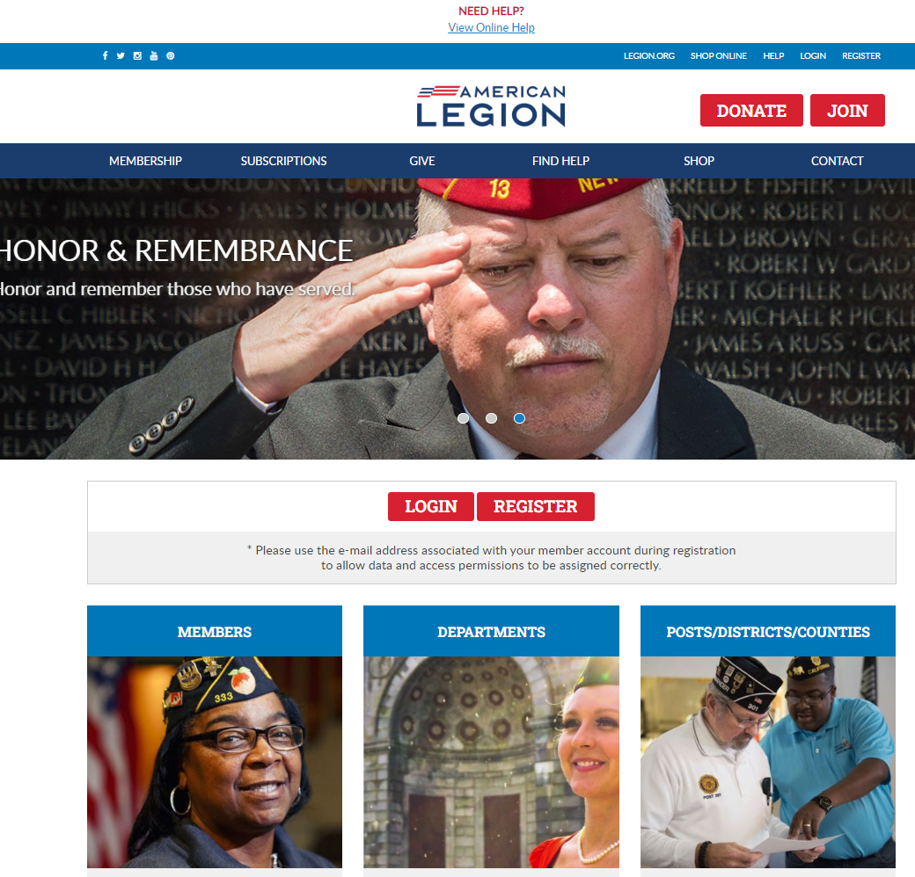

Log in or register a myLegion account to view and manage membership.
Notes:
Administrative membership management tools are available through MyLegion. Begin by logging into MyLegion.

Slide 3
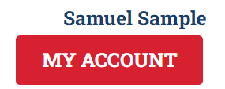
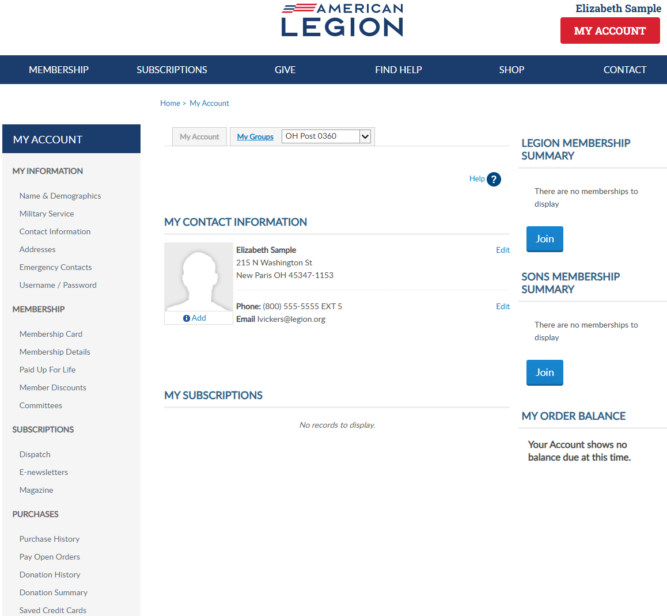

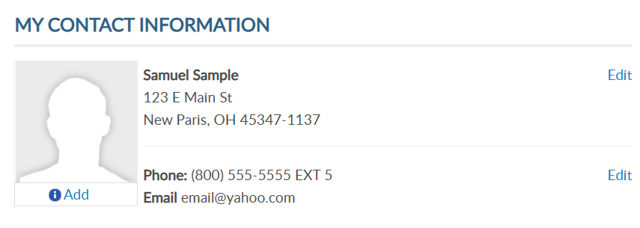
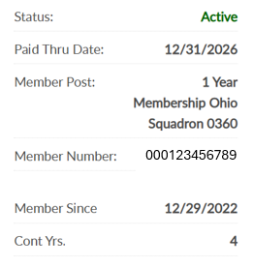
Adjutants, commanders and assigned admins will have a MyGroups menu.
MYLEGION.ORG
No group menu? Contact your department headquarters.
Notes:
My Groups is the administrative side of myLegion available to adjutants and commanders and assigned administrators. <1> If you do not have a My Groups menu and are a current adjutant or commander, contact your department headquarters.

Slide 4

Online Membership Processing
IMPORTANT INFO
Payment information is entered when finalizing the first transmittal and stored for future batches. A second transmittal cannot be finalized until the first one completes to ensure stored payment information is valid.
Notes:
Important information to know about online membership processing.
Payment information is entered when finalizing the first transmittal and stored for future batches. A second transmittal cannot be finalized until the first completes. This hold is to ensure payment information is stored correctly and to prevent multiple declines. Attempting to finalize a transmittal prior to the first one completing will result in an error message. This hold is activated each time new bank information is entered.

Slide 5

Online Membership Processing
IMPORTANT INFO
Open batches must be finalized within 14 days, or it will be removed, and a new batch will need to be created.
Notes:
Open batches are to be finalized within 14 days. Reminders to submit are emailed to adjutants and are deleted if no action is taken. All members in the transmittal will have to be re-entered in a new batch.

Slide 6

Online Membership Processing
IMPORTANT INFO
Pending transmittals in process must complete prior to making any adjustments
Renewing a member for the incorrect membership year or any other adjustments are reported to your department.
Transmittals complete in 7-14 business days. Member records are updated when posted. Review transmittal history to view batch status.
$10,000 batch limit.
Notes:
Pending transmittals in process must complete before any adjustments can be made. Renewing a member for the incorrect membership year or any other adjustments are to be reported to your department.
<1> Current processing time is 7-14 business days. Member records are updated when the batch is posted. Review transmittal history to view batch status.
<2> There is a $10,000 batch limit. Amounts higher than that should be broken down to separate transmittals that meet the limit.

Slide 7
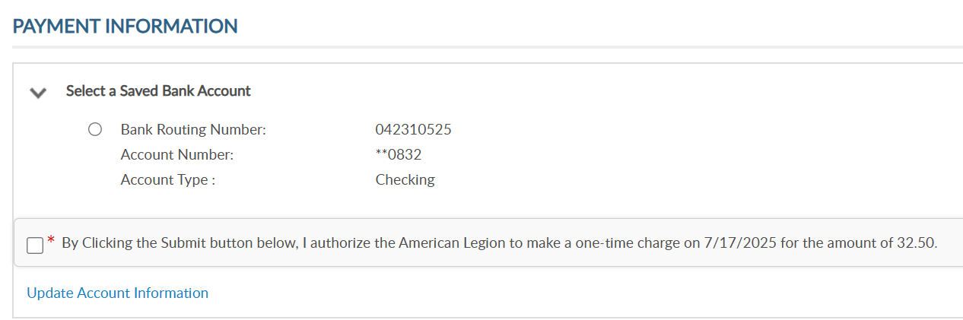
Online Membership Processing
IMPORTANT INFO
Stored bank information can be updated when finalizing a transmittal. On the payment window, select “Update Account Information”.
123456789
**1234
Notes:
Stored bank information can be updated when finalizing a transmittal. On the payment window, select “Update Account Information”.

Slide 8
Online Membership Processing
IMPORTANT INFO
Declined transmittal notifications are sent to adjutants. Declined batches can be resubmitted. Contact myLegion support for questions regarding declined batches.
Available for posts, squadrons, detachments and departments. District and County groups do not have online membership processing.
Notes:
Declined batches can be resubmitted. Contact myLegion support for questions regarding declined batches.
<1> Online membership processing is available for posts, squadrons, detachments and departments. Distirct and County groups do not have this feature.

Slide 9
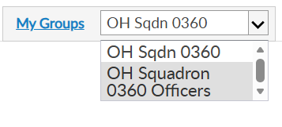
MY GROUPS
Adjutants and Commanders
Post, Squadron, District, County, Dept, Detach
Legion has LGN and SAL
Officer Groups: view only
Select group to transition to the admin side of myLegion.
Notes:
Legion leadership have access to both legion and Sons of the American Legion groups. Officer groups are view only. All officers are reported through department headquarters.
This member is a squadron adjutant. Squadron adjutants and commanders have access to 2 groups; squadron membership and officer groups.
<1> Clicking on the group will navigate you to the administrative side of MyLegion.

Slide 10
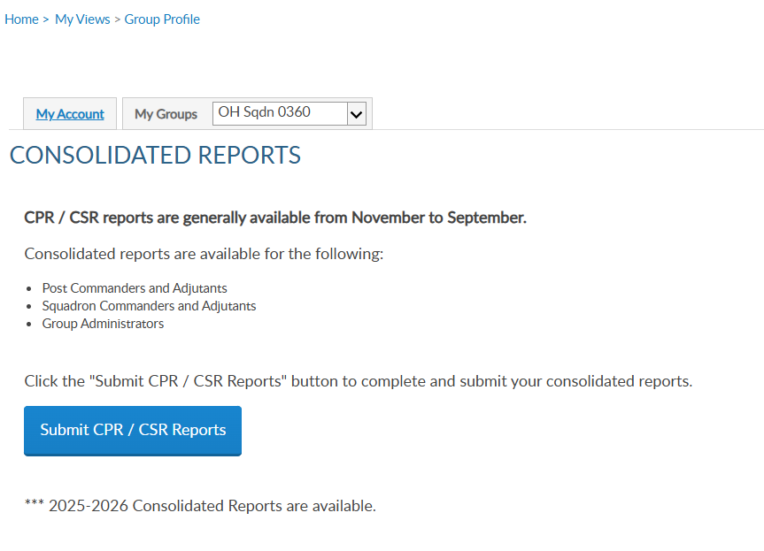
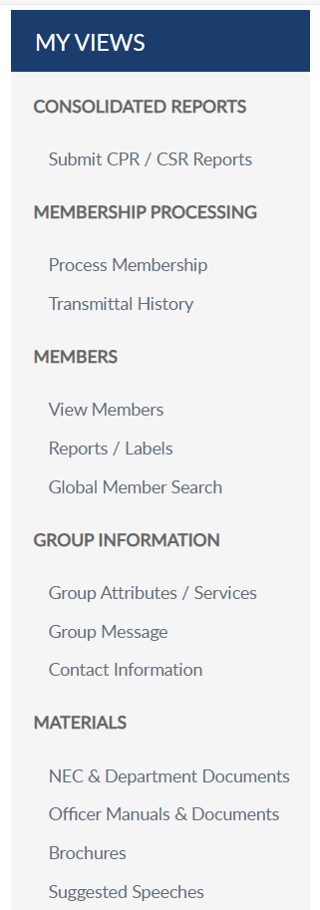
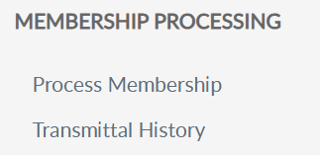
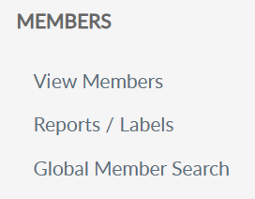
ONLINE MBRSHP PROCESSING
Notes:
Create a transmittal by going to Process Membership. You can also access membership processing through View Members. <1> Either option opens the Members window.
In this example, we will add and finalize a squadron transmittal. The squadron is selected in group menu, click Process Membership.

Slide 11
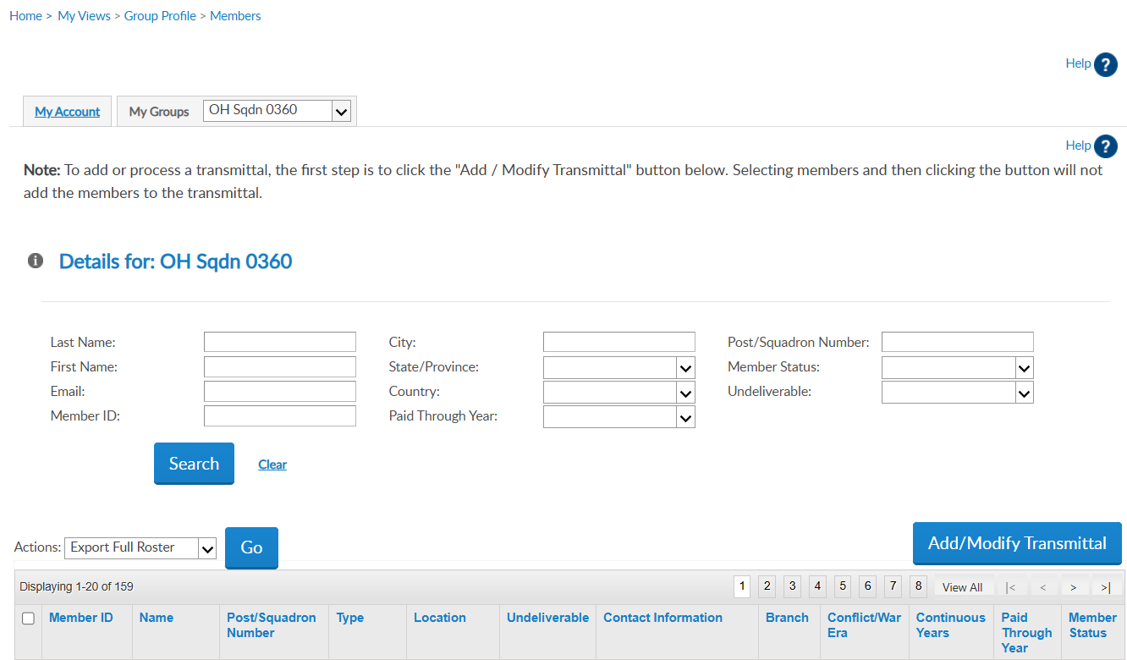

123456781 | Adams, James | Sons of American Legion OH Squadron 0360 | 1 Year Mbrship | Address |  | email address Phone | Unknown | Unknown | 5 | 2025 | Expired
123456782 | Allen, Sam | Sons of American Legion OH Squadron 0360 | 1 Year Mbrship | Address |  | Phone |  |  | 49 | 2026 | Active
123456783 | Baker, Matt | Sons of American Legion OH Squadron 0360 | 1 Year Mbrship | Address |  | email address Phone |  |  | 20 | 2026 | Active
VIEW MEMBERS LIST
102222456
Notes:
View members display current, expired and deceased members.

Slide 12
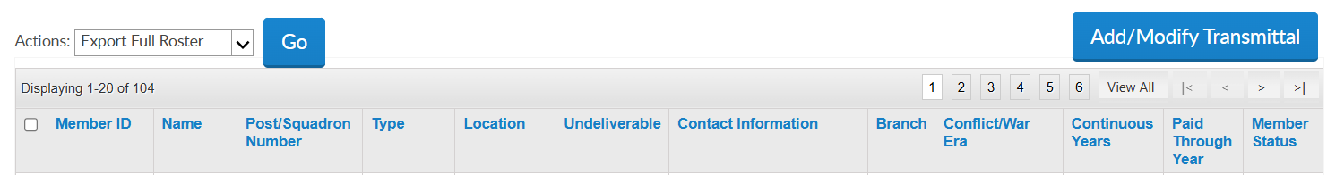
123456781 | Adams, James | Sons of American Legion OH Squadron 0360 | 1 Year Mbrship | Address |  | email address Phone | Unknown | Unknown | 5 | 2025 | Expired
123456782 | Allen, Sam | Sons of American Legion OH Squadron 0360 | 1 Year Mbrship | Address |  | Phone |  |  | 49 | 2026 | Active
123456783 | Baker, Matt | Sons of American Legion OH Squadron 0360 | 1 Year Mbrship | Address |  | email address Phone |  |  | 20 | 2026 | Active
201654321 | Bales, Cary | Sons of American Legion OH Squadron 0360 | 1 Year Mbrship | Address | Y |  |  |  | 1 | 2025 | Expired
123456785 | Combs, Ralph | Sons of American Legion OH Squadron 0360 | 1 Year Mbrship | Address |  | email address Phone |  |  | 1 | 2025 | Expired
202654322 | Davis, Dakota | Sons of American Legion OH Squadron 0360 | 1 Year Mbrship | Address |  | email address |  |  | 1 | 2025 | Expired
123456789 | Farmer, Jesse | Sons of American Legion OH Squadron 0360 | 1 Year Mbrship | Address |  |  |  |  | 42 | 2026 | Active
VIEW MEMBERS LIST
Notes:
View members displays the Paid Through Year. Members paid for the current membership year are not eligible for renewal and will not be on the renewal list. To begin a transmittal, click “Add/Modify Transmittal”. <1>

Slide 13
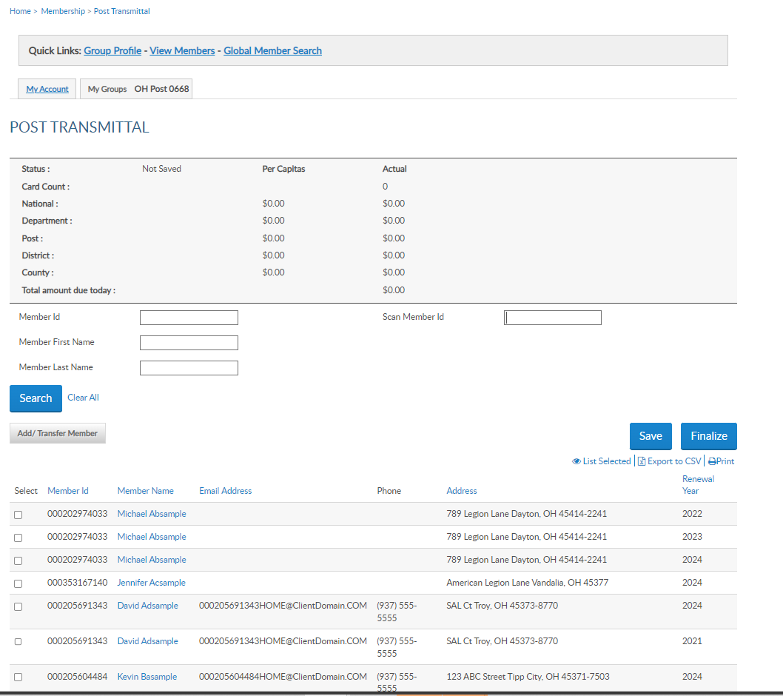
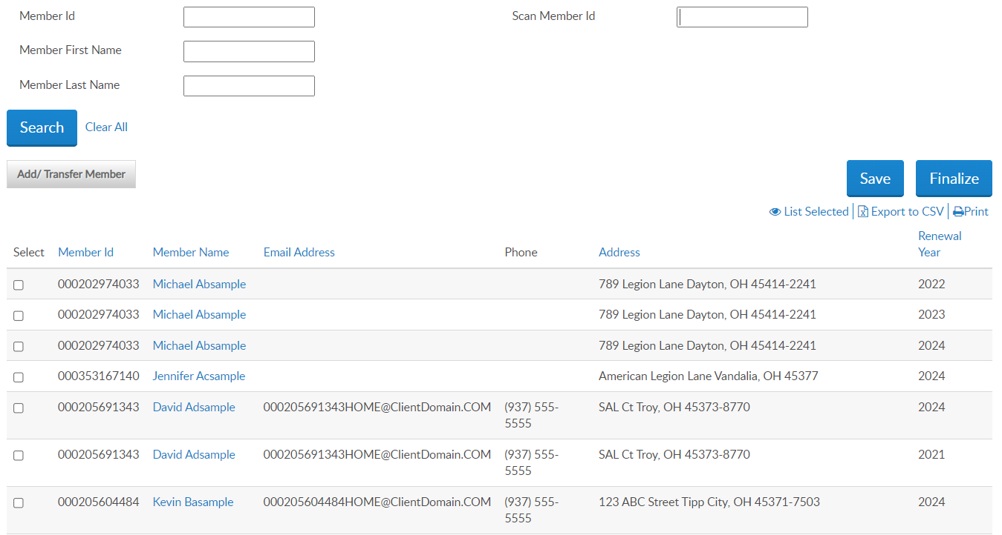
Member is already paid.
Member is in pending batch.
Member is deceased.
Transferred out of post/squadron.
Expired / no renewal order exists.
Resources: Transmittal History, Current Roster, Roster Update reports.
Member not in the renewal list?
123456781 | Adams, James | Email | Phone | Address | 2026
201654321 | Bales, Cary | Email | Phone | Address | 2026
123456785 | Combs, Ralph | Email | Phone | Address | 2026
202654322 | Davis, Dakota | Email | Phone | Address | 2026
123456789 | Farmer, Jesse | Email | Phone | Address | 2026
350456785 | Hardy, Ken | Email | Phone | Address | 2026
201222333 | Jackson, Herb | Email | Phone | Address | 2026
123456789
Paid members do
not display in the renewal list. Eligible renewal year(s) display.
RENEWAL LIST
123456789
123456789
123456000
123454321
123454321
1234543222
Notes:
If you do not find the member to renew, the member is either already paid, in a pending transmittal, transferred out of your post, or expired. Tools available to determine the members’ status are in Transmittal History, Current Roster, and Roster Updates.

Slide 14

Renewal list is alphabetized. Search member by ID or name, check renewal year and Save.
123456781 | Adams, James | Email | Phone | Address | 2026
201654321 | Bales, Cary | Email | Phone | Address | 2026
123456785 | Combs, Ralph | Email | Phone | Address | 2026
202654322 | Davis, Dakota | Email | Phone | Address | 2026
123456789 | Farmer, Jesse | Email | Phone | Address | 2026
350456785 | Hardy, Ken | Email | Phone | Address | 2026
201222333 | Jackson, Herb | Email | Phone | Address | 2026
RENEWAL LIST
123456789
123456789
123456789
123456000
123454321
123454321
1234543222
Notes:
The renewal list is alphabetical. To add a member to the batch, select the box for the correct renewal year. You can search for a member by ID or name.

Slide 15

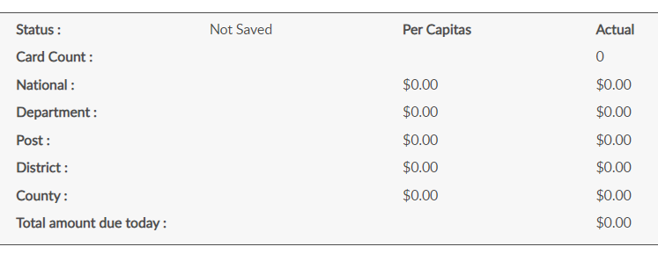
Online Help
Transmittal Summary
RENEWAL LIST
123456781 | Adams, James | Email | Phone | Address | 2026
201654321 | Bales, Cary | Email | Phone | Address | 2026
123456785 | Combs, Ralph | Email | Phone | Address | 2026
202654322 | Davis, Dakota | Email | Phone | Address | 2026
123456789 | Farmer, Jesse | Email | Phone | Address | 2026
350456785 | Hardy, Ken | Email | Phone | Address | 2026
201222333 | Jackson, Herb | Email | Phone | Address | 2026
Notes:
The squadron transmittal page opens to begin the batch. The transmittal summary includes transmittal status, number of cards, and per capita allocations. Total amount includes national and department only. These amounts do not display until a member is added to the batch, The summary area recalculates with each entry.

Slide 16
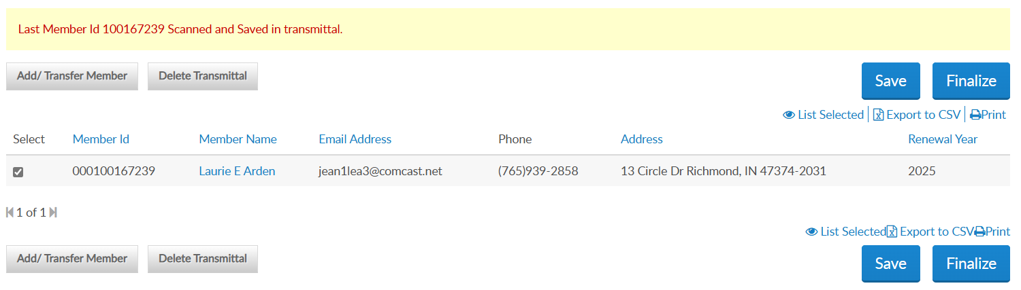
Scan Member ID quickly adds member to batch for current renewal year. Type member ID# and “enter”.
123456785
Last Member Id 123456785 Scanned and Saved in transmittal.
123456781 | Adams, James | Email | Phone | Address | 2026
201654321 | Bales, Cary | Email | Phone | Address | 2026
123456785 | Combs, Ralph | Email | Phone | Address | 2026
202654322 | Davis, Dakota | Email | Phone | Address | 2026
123456789 | Farmer, Jesse | Email | Phone | Address | 2026
350456785 | Hardy, Ken | Email | Phone | Address | 2026
201222333 | Jackson, Herb | Email | Phone | Address | 2026
123456789
2026
123456785 Ralph Combs Email Phone Address 2025
123456789
123456789
123456000
123454321
123454321
1234543222
Notes:
The scan member ID field is for departments and large posts using bar code scanners. This allows you to scan the barcode from the membership card to auto enter in the field. The 'Scan Member Id' box only applies to the current membership year and saves the record to the batch. However, you don't have to use a scanner to utilize the "Scan Member Id" box; you can just type the ID and hit enter and it will add the member to the transmittal. <1>
With each current year renewal, hit “enter” and scan or type ID of the next renewal. Scan by ID automatically saves the batch.

Slide 17
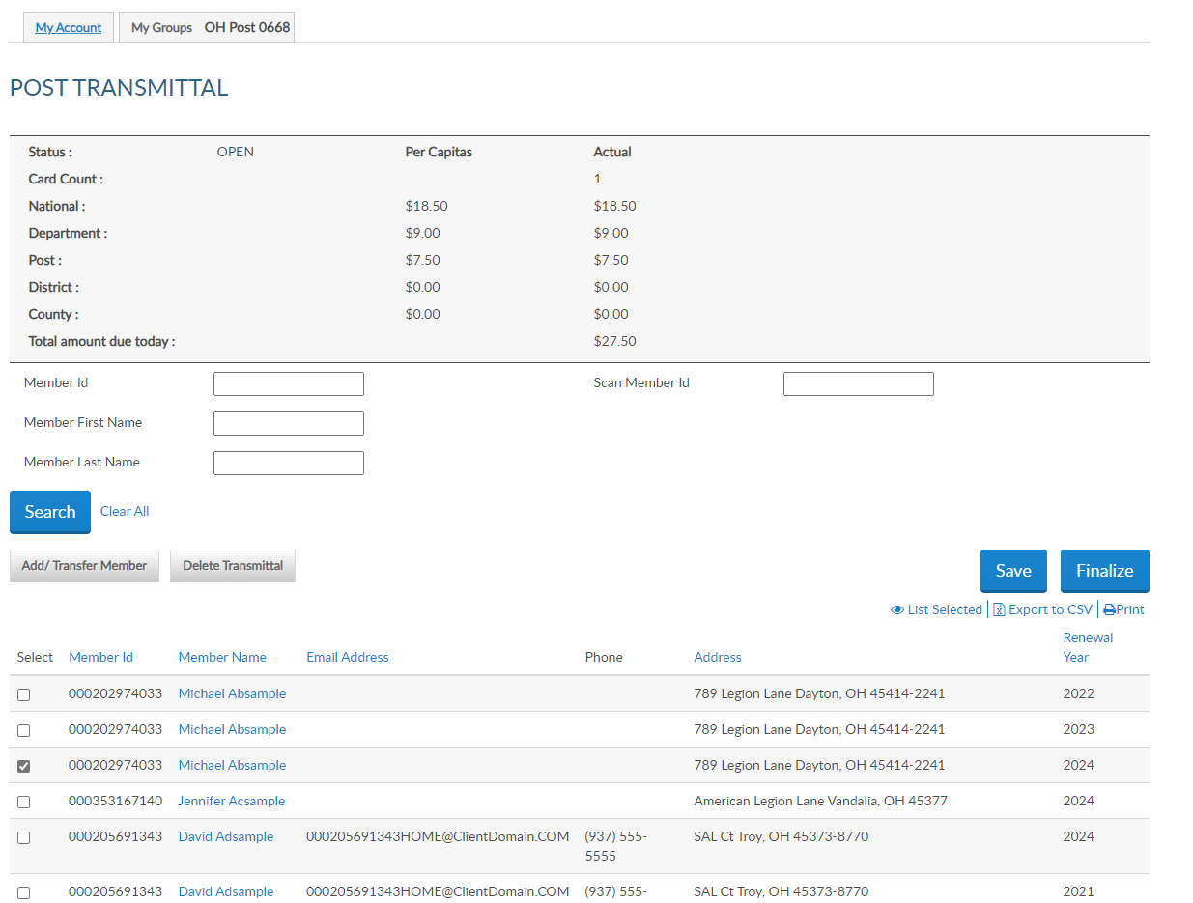
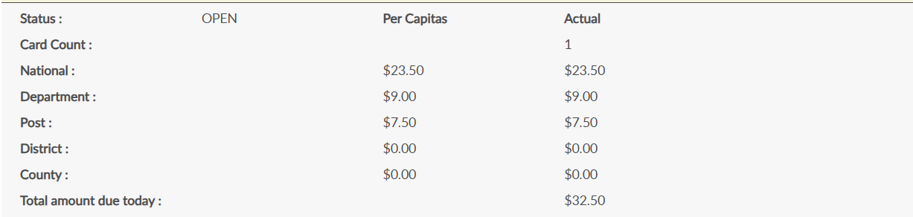
Past Dues Payments
Contact your department HQs to add a renewal for previous year(s).
123456781 | Adams, James | Email | Phone | Address | 2026
201654321 | Bales, Cary | Email | Phone | Address | 2026
123456785 | Combs, Ralph | Email | Phone | Address | 2026
202654322 | Davis, Dakota | Email | Phone | Address | 2026
123456789 | Farmer, Jesse | Email | Phone | Address | 2026
350456785 | Hardy, Ken | Email | Phone | Address | 2026
201222333 | Jackson, Herb | Email | Phone | Address | 2026
Renewed Member
Notes:
The member’s renewal is checked, adding the member to the batch and updating the transmittal summary. <1> If the member is paying past dues, contact your department headquarters who can add a previous year renewal.

Slide 18
Saving a transmittal Opens the batch and the summary updates.
Open batches must be submitted within 14 days, or it will be deleted.
123456781 | Adams, James | Email | Phone | Address | 2026
201654321 | Bales, Cary | Email | Phone | Address | 2026
123456785 | Combs, Ralph | Email | Phone | Address | 2026
202654322 | Davis, Dakota | Email | Phone | Address | 2026
123456789 | Farmer, Jesse | Email | Phone | Address | 2026
350456785 | Hardy, Ken | Email | Phone | Address | 2026
201222333 | Jackson, Herb | Email | Phone | Address | 2026
Renewed Member
Notes:
The batch summary amount due calculates with each member added to the batch. The total amount due equals the detachment and national per capita only.
<1> Saving the batch updates the status to Open. Open batches must be finalized in 14 days, or it will be removed. The batch will have to be re-entered.
Continue renewing members using search to check the renewal year. Save each entry as you go if not using scan member ID and when all names are added finalize the batch. Exiting this area without saving the batch will result in having to re-enter any entries made.

Slide 19



Online Help
123456781 | Adams, James | Email | Phone | Address | 2026
201654321 | Bales, Cary | Email | Phone | Address | 2026
123456785 | Combs, Ralph | Email | Phone | Address | 2026
202654322 | Davis, Dakota | Email | Phone | Address | 2026
123456789 | Farmer, Jesse | Email | Phone | Address | 2026
350456785 | Hardy, Ken | Email | Phone | Address | 2026
201222333 | Jackson, Herb | Email | Phone | Address | 2026
1234543222
Notes:
To add a new member, select the Add/Transfer Member button.

Slide 20
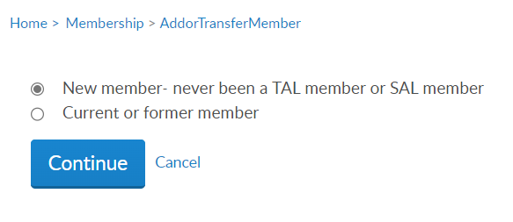
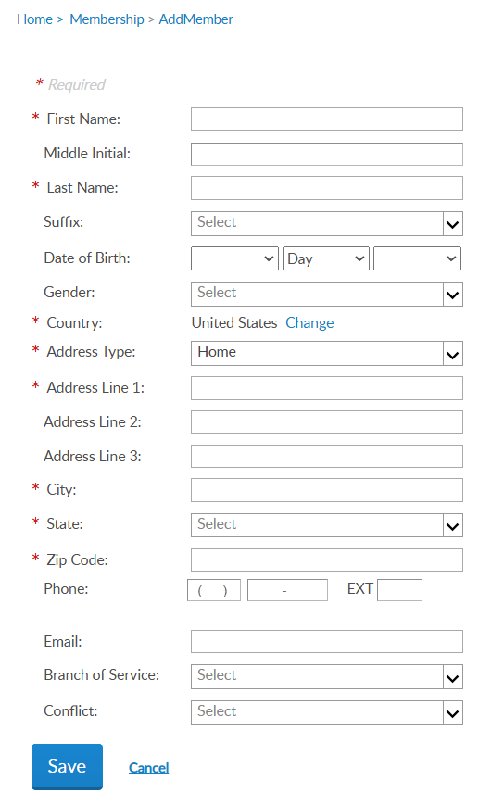
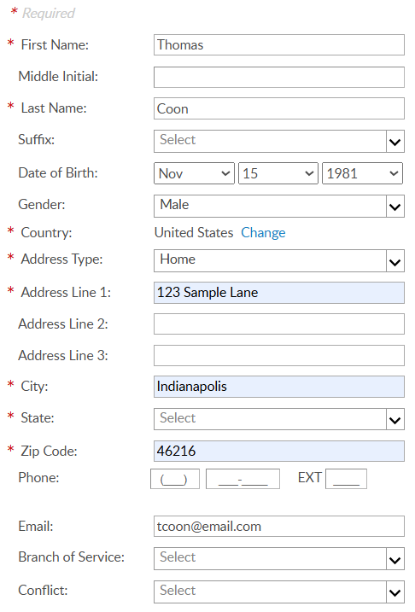
Online Help
Notes:
Select “new member – never been an American Legion or Sons of the American Legion member and click continue.
Enter the members’ information and save. <1> Fields with an asterisk are required. To enter a foreign address, use the pulldown menu in country, to select country.

Slide 21
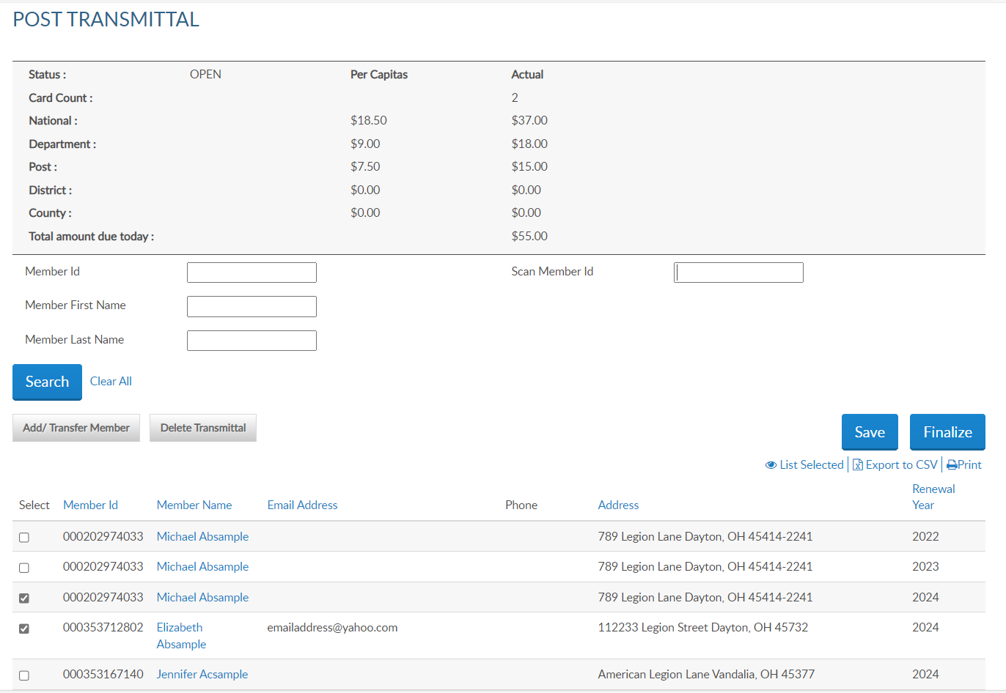
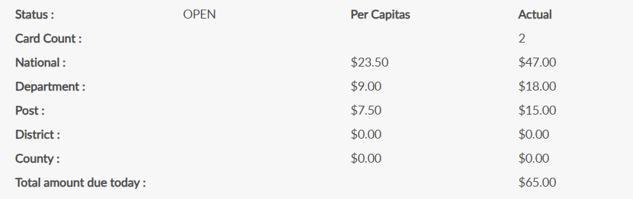
Online Help
123456781 | Adams, James | Email | Phone | Address | 2026
201654321 | Bales, Cary | Email | Phone | Address | 2026
123456785 | Combs, Ralph | Email | Phone | Address | 2026
351234567 | Coon, Thomas | Email | Phone | Address | 2026
202654322 | Davis, Dakota | Email | Phone | Address | 2026
123456789 | Farmer, Jesse | Email | Phone | Address | 2026
 |  | Email | Phone | Address | 2026
New
Member
Notes:
The new member is added to the list and the summary updates.
Save each entry to prevent losing members in the batch. Always save the batch before exiting.

Slide 22
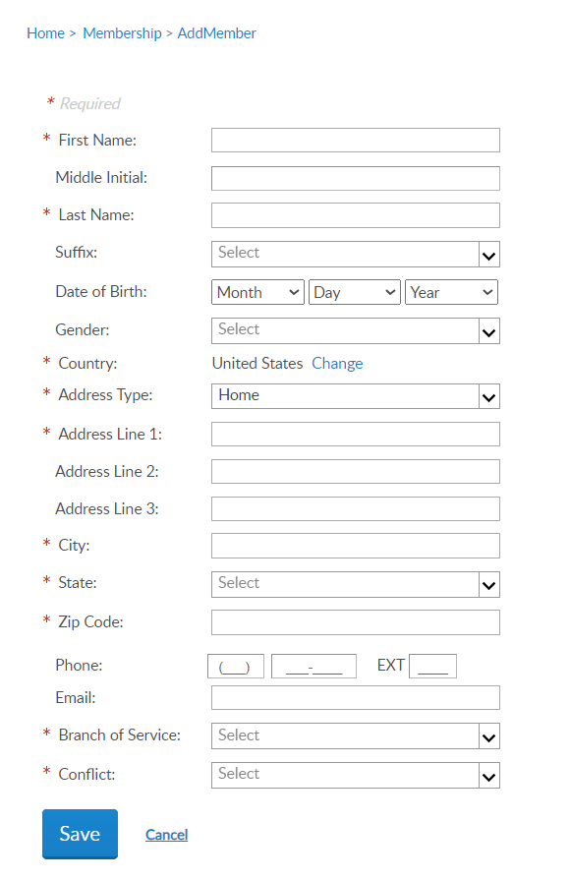

Online Help
Add Member Error
Member is expired with an existing ID number.
New member created a MyLegion account prior to joining.
New member has existing Legion membership.
Capture ID#, return to batch and enter as “current or former member” to create a current renewal order.
Notes:
You will receive an error message “A Customer exists with matching details and provides the member ID” because the member is deeply expired, and no renewal order exists to fulfill, the new member has created a myLegion account prior to joining, or they are already a member of The American Legion.
If this message appears, capture the ID number, click cancel to return to post transmittal, and process as current or former member.

Slide 23

Online Help
Transfer must include payment. Paid member transfers are reported using Member Data Form.
123456781 | Adams, James | Email | Phone | Address | 2026
201654321 | Bales, Cary | Email | Phone | Address | 2026
123456785 | Combs, Ralph | Email | Phone | Address | 2026
351234567 | Coon, Thomas | Email | Phone | Address | 2026
202654322 | Davis, Dakota | Email | Phone | Address | 2026
123456789 | Farmer, Jesse | Email | Phone | Address | 2026
 |  | Email | Phone | Address | 2026
Notes:
The next transaction available using online membership processing is transferring members into your post. Only members that are renewing dues can be transferred online. To transfer paid members, complete a Member Data Form and send to your department.
To transfer a renewing member, select Add/Transfer Member.

Slide 24
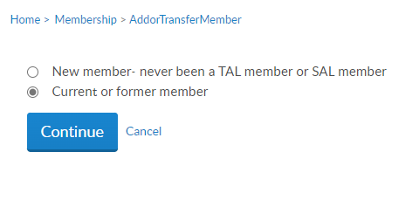
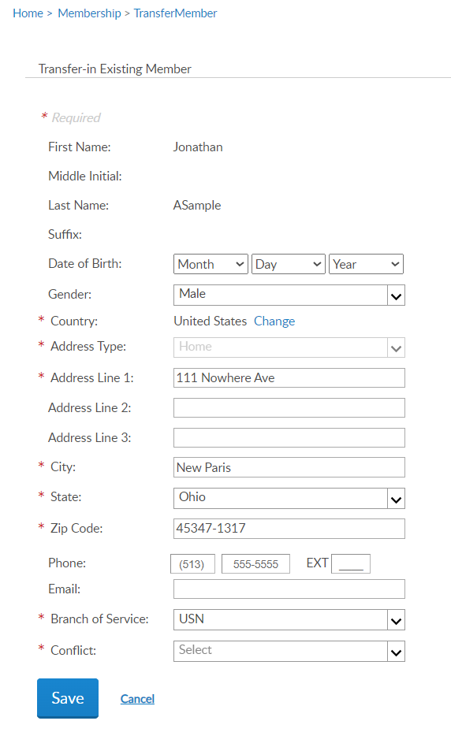
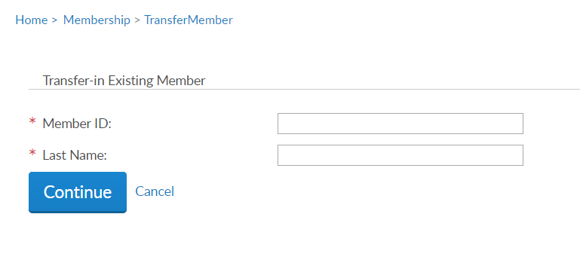
Online Help
Jack
Aaron
Notes:
Select current or former member and continue. Enter the member ID# and last name and continue.
Update any information needed and add any required data. Click Save to add the member to the batch.

Slide 25
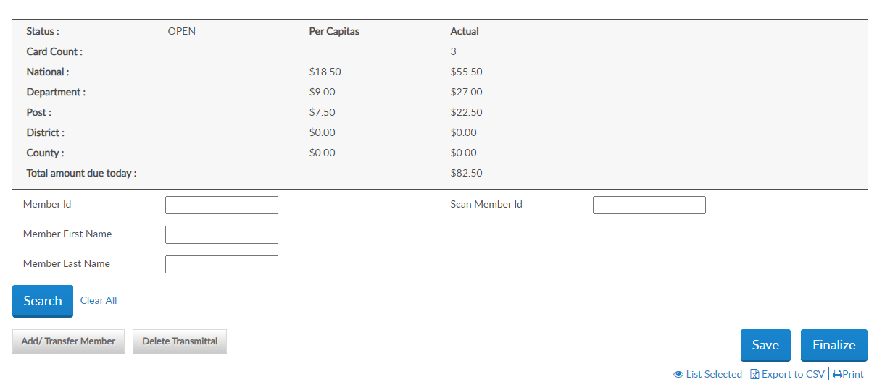
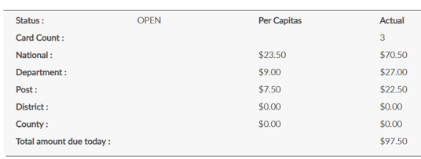
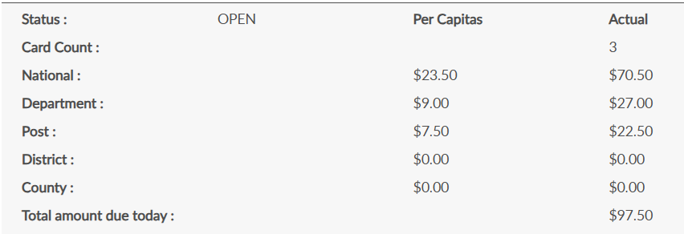
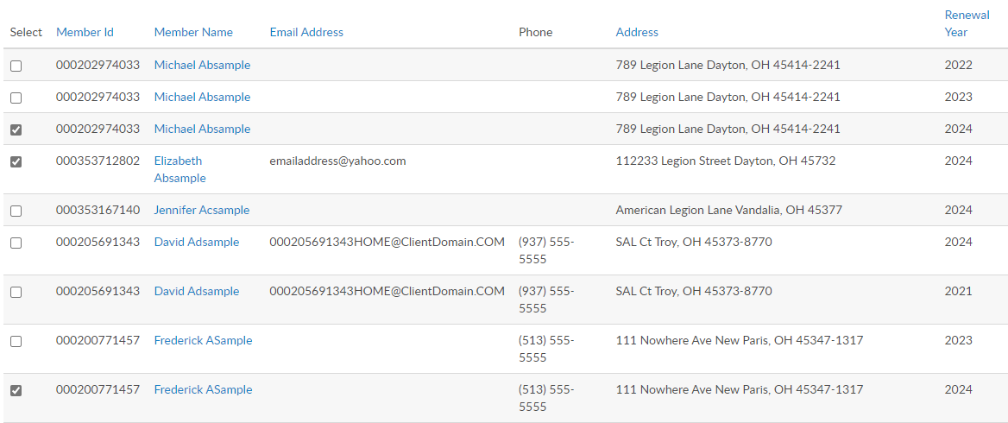

Online Help
Transferred
Member
123456900 | Aaron, Jack | Email | Phone | Address | 2026
123456781 | Adams, James | Email | Phone | Address | 2025
201654321 | Bales, Cary | Email | Phone | Address | 2026
123456785 | Combs, Ralph | Email | Phone | Address | 2026
351234567 | Coon, Thomas | Email | Phone | Address | 2026
202654322 | Davis, Dakota | Email | Phone | Address | 2026
123456789 | Farmer, Jesse | Email | Phone | Address | 2025
350456785 | Hardy, Ken | Email | Phone | Address | 2026
201222333 | Jackson, Herb | Email | Phone | Address | 2026
123454321
122333444
122333444
Notes:
The Summary recalculates with the total amount due. The amount due equals detachment plus national per capita.

Slide 26

Online Help
Remove people from batch by unchecking the box or delete entire transmittal.
123456900 | Aaron, Jack | Email | Phone | Address | 2026
123456781 | Adams, James | Email | Phone | Address | 2025
201654321 | Bales, Cary | Email | Phone | Address | 2026
123456785 | Combs, Ralph | Email | Phone | Address | 2026
351234567 | Coon, Thomas | Email | Phone | Address | 2026
202654322 | Davis, Dakota | Email | Phone | Address | 2026
123456789 | Farmer, Jesse | Email | Phone | Address | 2025
350456785 | Hardy, Ken | Email | Phone | Address | 2026
201222333 | Jackson, Herb | Email | Phone | Address | 2026
123454321
122333444
122333444
Notes:
To remove members from the transmittal, uncheck the box next to the name and the summary will recalculate. To delete the whole transmittal, select “Delete Transmittal”.

Slide 27
Online Help
123456900 | Aaron, Jack | Email | Phone | Address | 2026
123456781 | Adams, James | Email | Phone | Address | 2025
201654321 | Bales, Cary | Email | Phone | Address | 2026
123456785 | Combs, Ralph | Email | Phone | Address | 2026
351234567 | Coon, Thomas | Email | Phone | Address | 2026
202654322 | Davis, Dakota | Email | Phone | Address | 2026
123456789 | Farmer, Jesse | Email | Phone | Address | 2025
350456785 | Hardy, Ken | Email | Phone | Address | 2026
201222333 | Jackson, Herb | Email | Phone | Address | 2026
Notes:
After all records are entered you can view the batch by clicking “List Selected”. The Finalize button directs you to the same page. Payment information will be entered during finalization if not already stored.
Open batches must be finalized within 14 days or automatically they will be removed. The members will have to be re-entered.

Slide 28
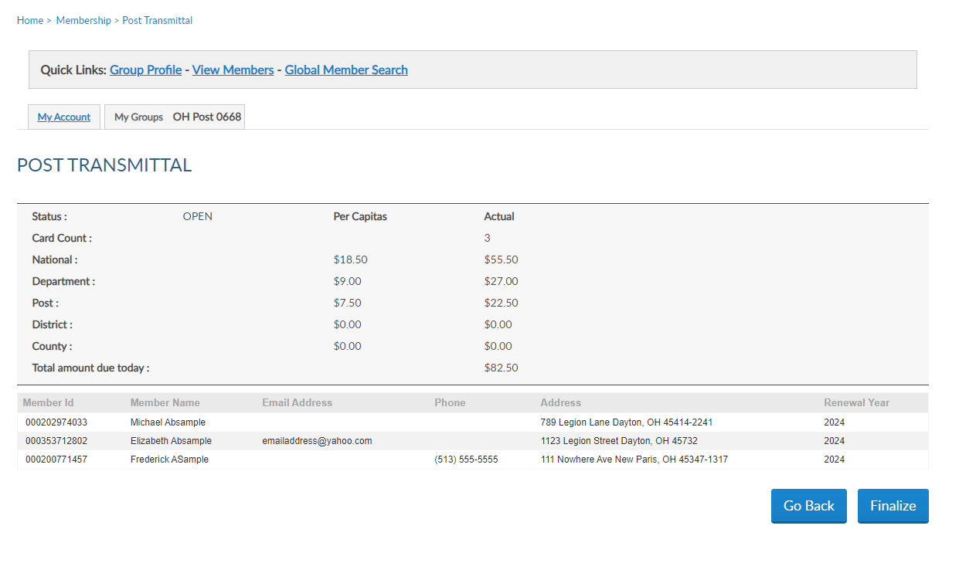
Online Help
123456900 | Jack Aaron | Email | Phone | Address | 2026
123456785 | Ralph Combs | Email | Phone | Address | 2026
351234567 | Thomas Coon | Email | Phone | Address | 2026
Notes:
The summary displays the total members in the batch and the total amount due. Click finalize to continue or Go Back to return to transmittal list.

Slide 29
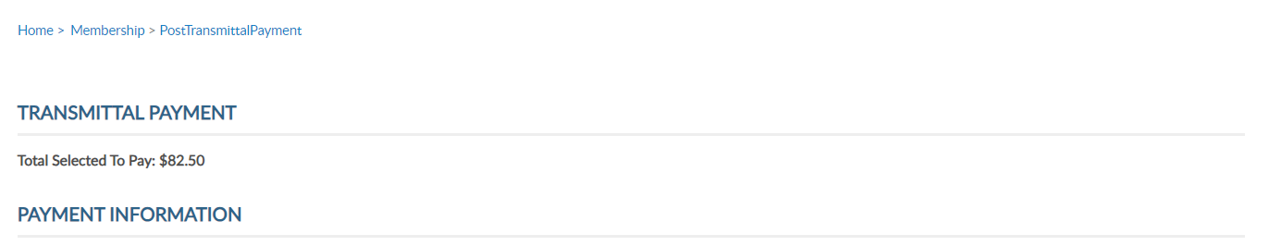
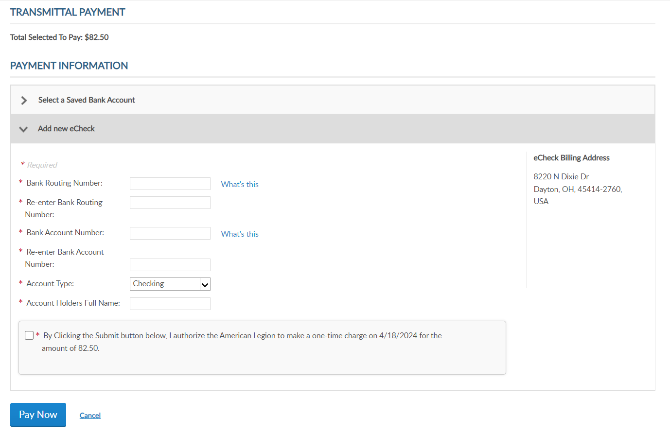
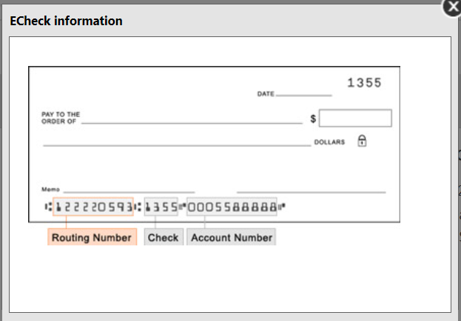
Online Help
Total Selected to Pay: $97.50
Address1
New Paris, OH
USA
* By Clicking the Submit button below, I authorize the American Legion to make a one-time charge on 2/18/2025 for $97.50.
* By Clicking the Submit button below, I authorize the American Legion to make a one-time charge on 2/3/2026 for $97.50.
Notes:
Payment information must be entered when finalizing your first transmittal. Enter the routing and bank account information. The Account Holder’s name is the name of the squadron bank account. When entering, use a specific description instead of a generic name as in American Legion squadron 1.
The easiest place to find your bank’s routing number is to look at your paper checks. The check will typically have the 9-digit routing number down on the bottom left of the check. All routing numbers are 9 digits.
Foreign squadrons can process membership with a credit card. Online membership processing is designed for payment to be processed with a squadron account and not with individual credit cards.
The only payment method for US squadrons is eCheck. Enter the bank account information, authorize the one-time charge by clicking the checkbox and Pay Now.
This information will be stored for future transmittals. Entering new payment information holds future transmittal from finalizing until the first transmittal completes. This is to ensure all subsequent transmittals have valid bank information.
If you receive an error when entering payment information, contact your financial institution to verify ACH payment account information.

Slide 30
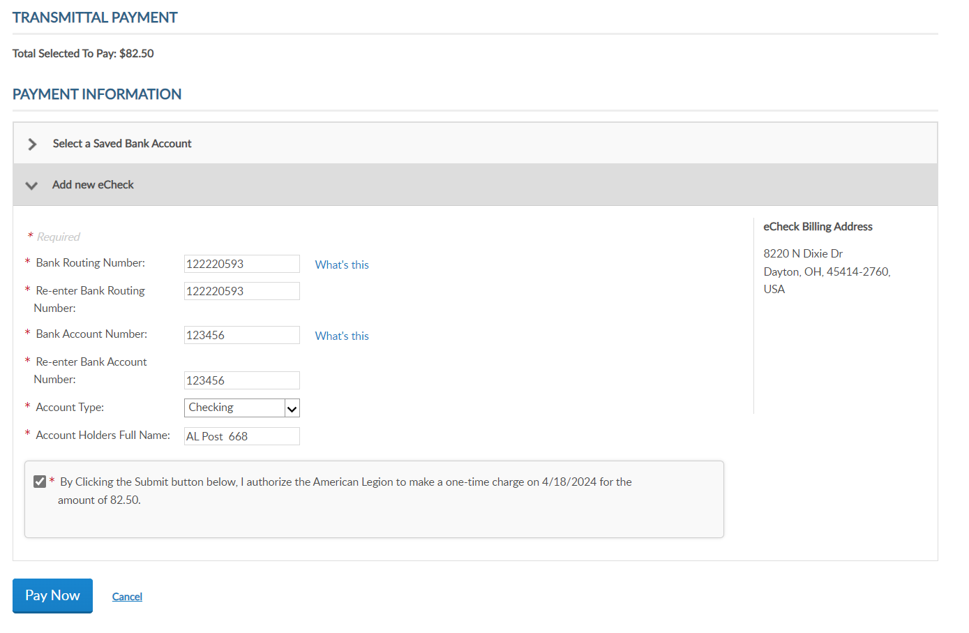
Online Help
Total Selected to Pay: $97.50
Address1
New Paris, OH
USA
OH Squad 360 AL
* By Clicking the Submit button below, I authorize the American Legion to make a one-time charge on 2/3/2026 for $97.50.
Notes:
After payment information is entered, click the authorization box and Pay Now.

Slide 31
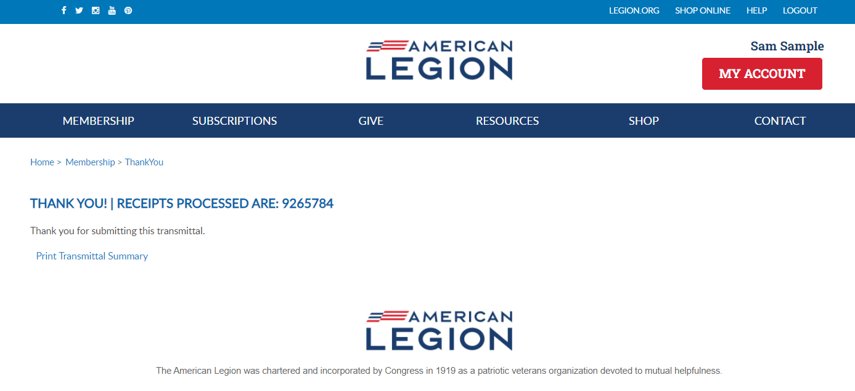

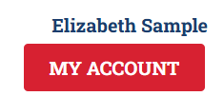
Online Help
Notes:
Finalization of a transmittal produces a receipt number. This is notification the transmittal has been received and is in process. While in pending status, counts are added to the National Target Date membership reports and are immediately available for Detachments to add to their membership reports. Members in a pending batch do not receive renewal notices, and are prevented from renewing online that creates duplicate payments.
To view the transmittal summary, and print the receipt, click Print Transmittal Summary.

Slide 32
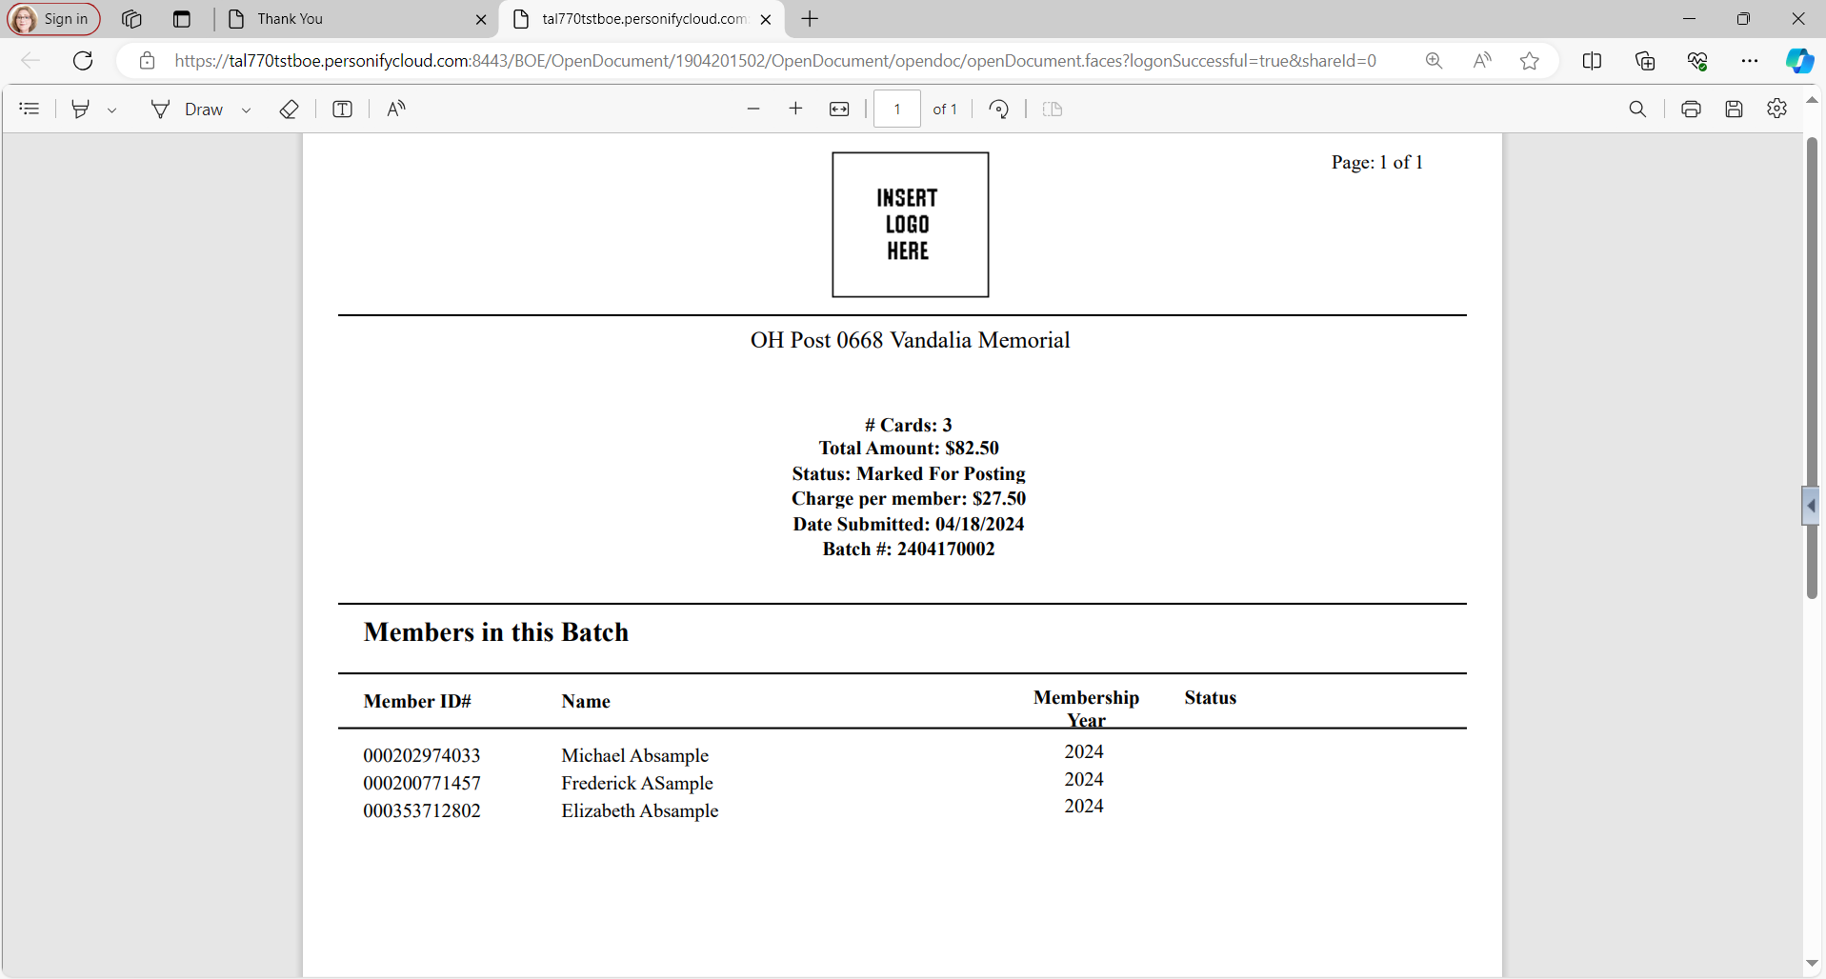
Online Help
OH Squadron 0360 Clarence Teaford
# Cards: 3
Total Amount: $97.50
Status: Marked For Posting
Charge per member: $32.50
Date Submitted: 02/03/2026
Batch #: 2602010002
123456900 | Jack Aaron | 2026
123456784 | Ralph Combs | 2026
351234567 | Thomas Coon | 2026
Notes:
The receipt opens in another tab to print or save this document for your records. This information is also available in your transmittal history.

Slide 33
Online Help
Notes:
Return to your group profile to view transmittal status and history. Go back to My Account > My Groups.

Slide 34
GROUP PROFILE
Notes:
From the left menu go to Transmittal History.

Slide 35
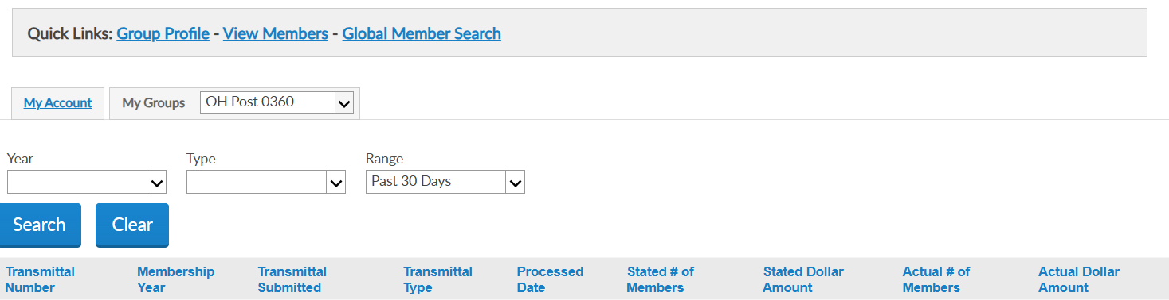

2601190001 2026 01/19/2026 Online 2026-01-27 0 $0.00 1 $32.50
2601220002 2026 01/22/2026 Online 2026-01-29 0 $0.00 1 $32.50
2602030003 2026 02/03/2026 Online IN PROCESS 0 $0.00 3 $97.50
Notes:
Transmittal history includes reference number, membership year, status, actual number of members submitted and total amount.
Using the Range search field, you can alter the history displayed. Custom range pulls up date fields to set the range of history. Online transmittal history is only available from April 1, 2021, to current.
Clicking on the transmittal number opens details including members in the batch, amount and status.

Slide 36
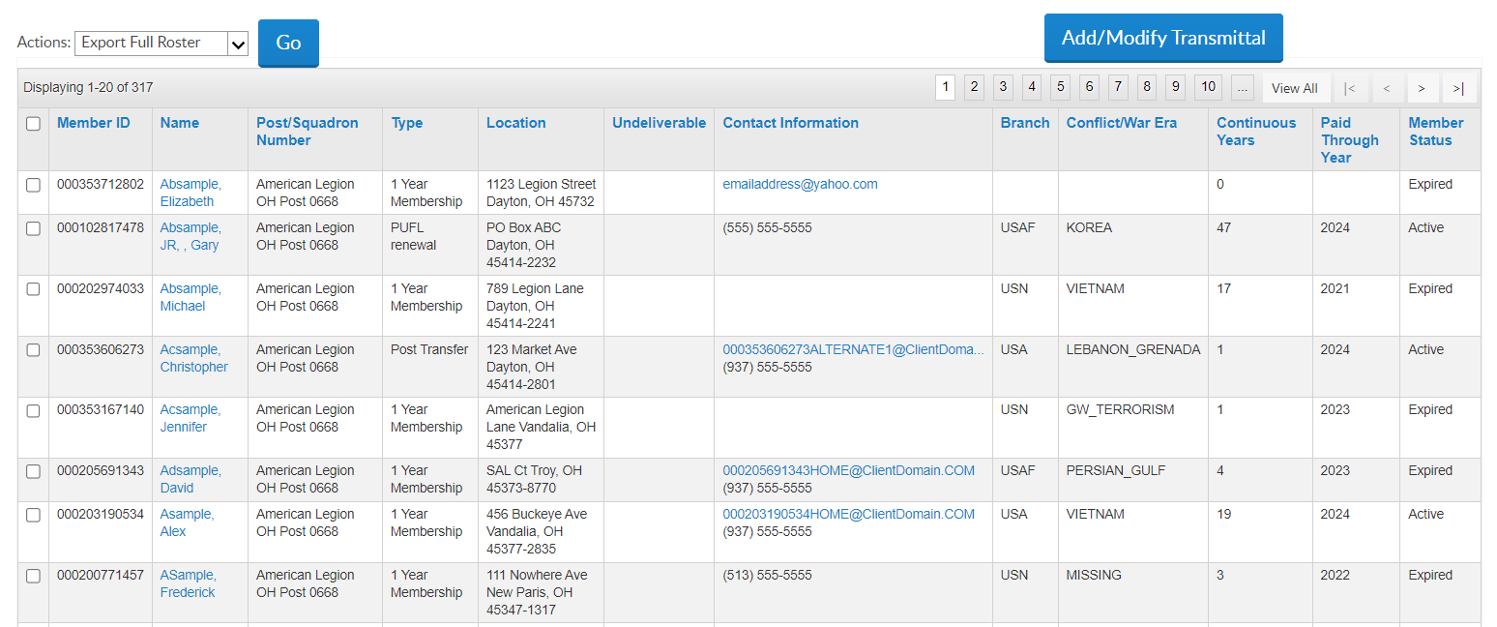
New members in pending batch are seen in View Members as Exp. With 0 cont yrs.
View Members List
123456781 | AaExample, James | Sons of American Legion OH Squadron 0360 | 1 Year Mbrship | Address |  | email address Phone | Unknown | Unknown | 5 | 2024 | Expired
123456782 | AaExample, Jr, Fred | Sons of American Legion OH Squadron 0360 | 1 Year Mbrship | Address |  | Phone |  |  | 49 | 2026 | Active
123456783 | AaSample, Allen | Sons of American Legion OH Squadron 0360 | 1 Year Mbrship | Address |  | email address Phone |  |  | 20 | 2026 | Active
351234567 | AbSample, Benjamin | Sons of American Legion OH Squadron 0360 | 1 Year Mbrship | Address |  |  |  |  | 0 | 2026 | Expired
123456789 | AcSample, Christopher | Sons of American Legion OH Squadron 0360 | 1 Year Mbrship | Address |  | email address Phone |  |  | 1 | 2025 | Expired
123456789 | AcSample, Christopher | Sons of American Legion OH Squadron 0360 | 1 Year Mbrship | Address |  | email address Phone |  |  | 1 | 2025 | Expired
123456788 | AdExample, Jon | Sons of American Legion OH Squadron 0360 | 1 Year Mbrship | Address |  |  |  |  | 42 | 2026 | Active
Coon, Thomas
Notes:
New members display in view members as expired with 0 continuous years. Once they batch completes, the new member becomes active with 1 continuous year.

Slide 37
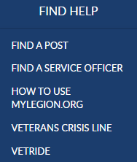
Notes:
Online help is available from the top Menu “Find Help”.
Step by step instructions, videos and training presentations will assist with how to manage groups in MyLegion.

Slide 38
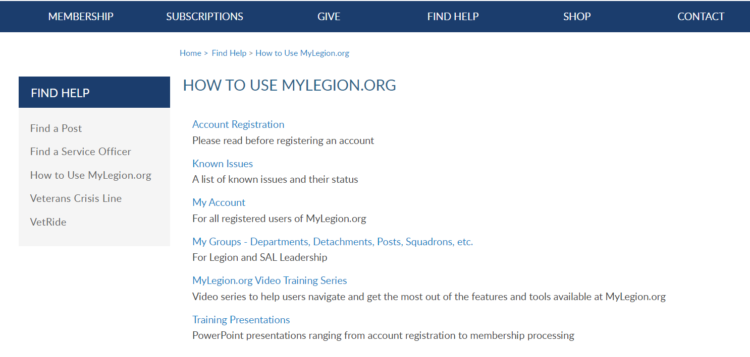
Online Help
Notes:
Step by step instructions, videos and training presentations will assist with how to manage groups in MyLegion. My Groups instructions include managing membership, online, membership processing, reports and all other administrative tasks.

Slide 39
MYLEGION SUPPORT
MyLegion@legion.org
833.253.9995
Monday – Friday
8:00am – 4:30pm
(Eastern)
The American Legion National HQs
5745 Lee Road
Indianapolis, IN 46216
Contact your MyLegion support team to assist with any questions or tools on your MyLegion account.
Notes:
Contact your myLegion support team to assist with questions and tools for MyLegion. Email mylegion@legion.org or call 833-253-9995 Monday through Friday.

